Slide 1
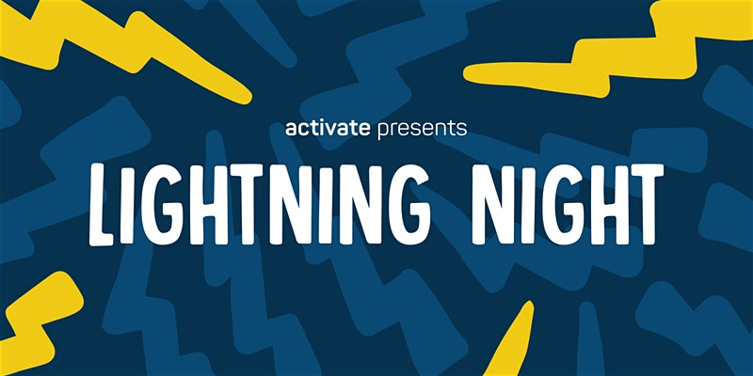
Personal Practical Cybersecurity William Assaf

Slide 2
Awareness is the best Digital Defense
“It’s difficult to ignore how commonplace large-scale hacks have become, and there’s no sign that this form of criminality is going to die off. There is no defense that’s 100 percent capable of blocking any kind of attack; criminals will always find a way to exploit even the smallest weakness. Although it’s not easy, the best way to stay safe online is to be aware of the threats, and aware of what can be done to safeguard against those threats.
Online security is like paying for insurance, or going to the dentist. It doesn’t seem that important, until it is. It’s not enough to simply opt-in to the forms of protection we’re offered by various sites and services. Knowing what kind of attacks these protections defend us from — and what they don’t — is the only way to take charge of your own security.”
Brad Jones, DigitalTrends, 2017 https://www.digitaltrends.com/computing/why-2-factor-security-is-flawed/

Slide 3
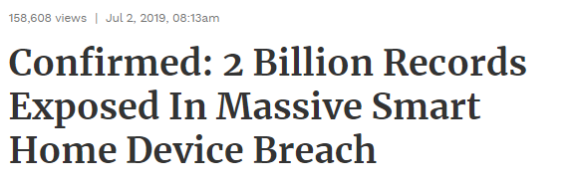
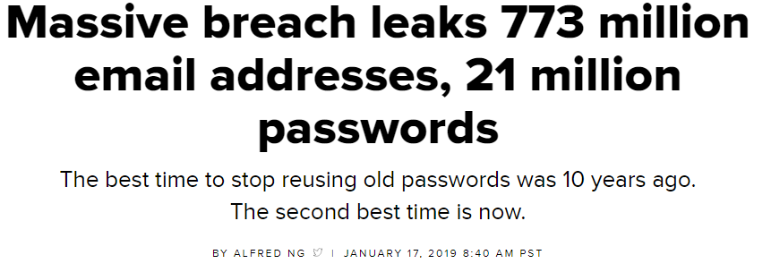
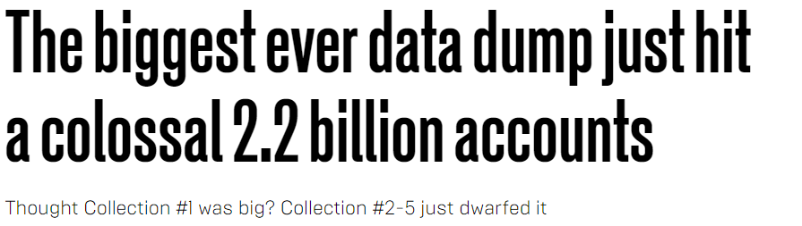
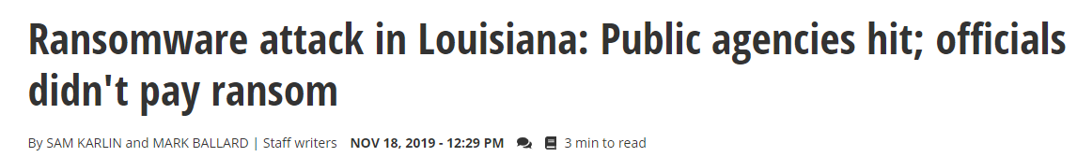
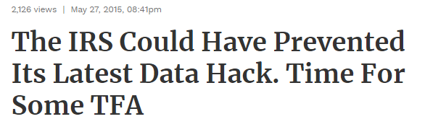
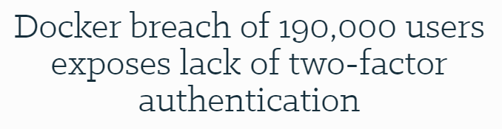
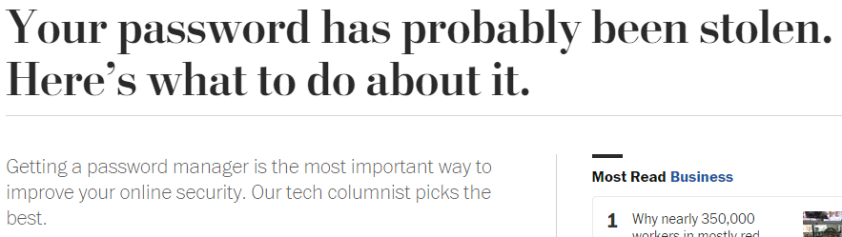
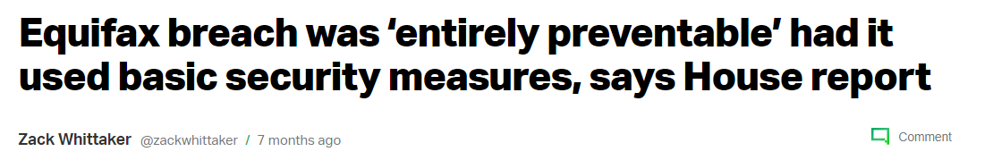
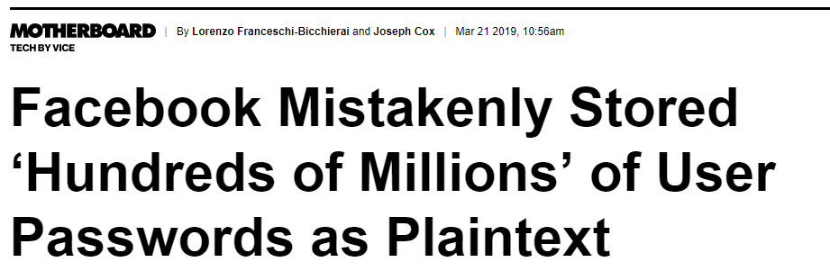
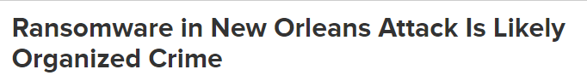
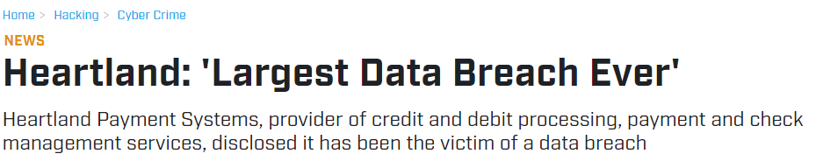
Don’t ever re-use passwords.
Yep, a new password for every login. Seriously.

Slide 4
What good is a super complex password when it is known?

Slide 5
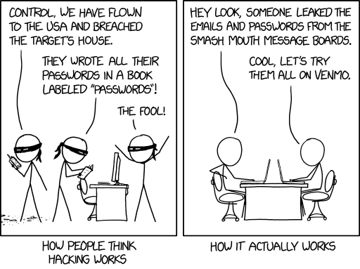
https://xkcd.com/2176/

Slide 6
Phishing
Of course you know about not clicking suspicious email links which are attempting to harvest your username/password via a fake but realistic-looking login page.
This is called “phishing”, or if they’re going after your job/role/title, “spear phishing”.
But what if they already know your username and password?

Slide 7
Password Hygiene
Has your email been part of any password leaks? haveibeenpwned.com
Spoiler alert: Almost Certainly
“People take lists like these that contain our email addresses and passwords then they attempt to see where else they work. The success of this approach is predicated on the fact that people reuse the same credentials on multiple services.” –Troy Hunt, haveibeenpwned.com

Slide 8
Password Hygiene
Password length > Password complexity
Policies of frequent changes = bad habits
Password uniqueness > Password length
Passwords alone are terrible security

Slide 9
Your Email Account > Your Bank Account
Having your email hacked can be worse than having your bank account hacked.
Your email (and your phone) are single points of failure.

Slide 10
You Should Use a Password Manager
Basic idea: You have one unique super password to unlock everything else.
Pro: All your passwords are long, strong, unique, and available to you anywhere
Con: forget that one unique super password, despite typing it in all the time? They cannot decrypt your passwords for you.

Slide 11
Password Managers
These are popular, secure, and inexpensive:
LastPass
1Password
Dashlane
KeePassX
RoboForm
Many browsers have built-in password features – not recommended because of lack of features and integration with all your devices.

Slide 12
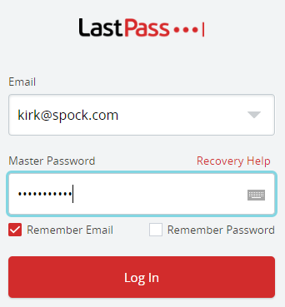
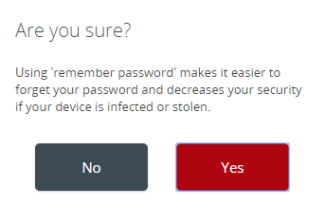
Password Managers
Exchange all your passwords for a single super password.
DO NOT set your single super password to be “remembered”, ever!
Also use MFA to access.

Slide 13
What is Multi Factor Authentication (MFA)
Passwords alone are terrible security
TFA or MFA (Two-factor or Multi-factor) authentication is something aside from a password that allows a website to confirm you are you.
Use MFA for Every Account You Can.

Slide 14
MFA is not new concept…
… but implementation is still developing and the industry has wasted decades trying to overcome consumers’ desire to be ignorant and stubborn.
Asymmetric encrypted hardware key algorithms have been around since 1970s, some weren’t declassified until late 90s
The RSA algorithm patent was made public domain in 2000
The first driverless, one-touch auth USB device in 2008
Google provided MFA to all accounts as early as 2010

Slide 15
Use MFA for Every Account You Can
Google/iCloud/Microsoft
Modern Banking/Financial/Bill Payment
Cloud storage/assets, Github, Bitbucket
Social media, e-commerce, Gaming and Streaming
Government, public service, utility providers
Want to know if a site supports MFA? twofactorauth.org or just got to the security settings/menu and see. Most do.

Slide 16
Common MFA Types
Text message (SMS)
Software-based authenticators
Certificate-based authenticators
Hardware-based authenticators

Slide 17
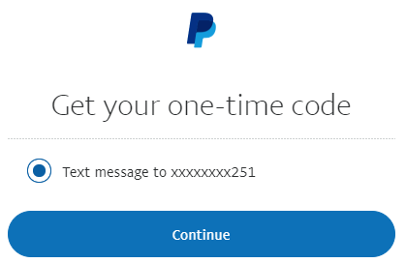

Text-Message (SMS) Based Authentication
After you log in, the website sends you an SMS.
You type in the number.
Vulnerable to many SS7 telecom protocol attacks.

Slide 18
Vulnerabilities in Cell Carriers
Man-in-the-middle SS7 telecom protocol attacks, SIM card swapping/cloning, and good old fashioned social engineering via customer support, have made SMS-based MFA obsolete
Almost every cellular network uses SS7.
High profile banking hacks in the UK have raised awareness of this.
SS7 hack explained: what can you do about it? https://www.theguardian.com/technology/2016/apr/19/ss7-hack-explained-mobile-phone-vulnerability-snooping-texts-calls

Slide 19
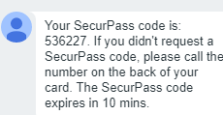
SMS-Based Scam Tactics
“I’m going to send you a secure code… to make sure you’re not a scammer”
They’re trying act as you to your cell carrier, to clone your cell phone.
If you get a code via SMS, NEVER PROVIDE IT TO ANYONE!
They are hijacking the beneficial phone number portability system that allows you to keep your number when you switch providers.
This is an actual scam!

Slide 20
SMS-Based Auth is Better Than Nothing
If offered an option besides SMS MFA, use it.
SMS-based MFA is much better than no MFA.
Yahoo and Reddit have each been breached after they were targeted by SMS-based MFA.

Slide 21
Email-Based Authentication
Email authentication’s vulnerability concept is similar to SMS-based authentication.
Compromise the email account, and the “other factor” is compromised via password reset, etc.
Also, Google and Apple offer integrated SMS in email, so SMS sent to your phone is visible in email. Same problem.
Still, much better than no MFA.

Slide 22
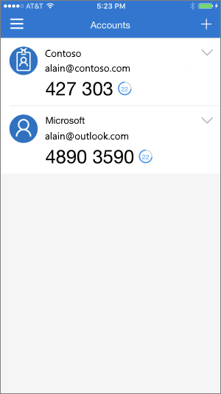
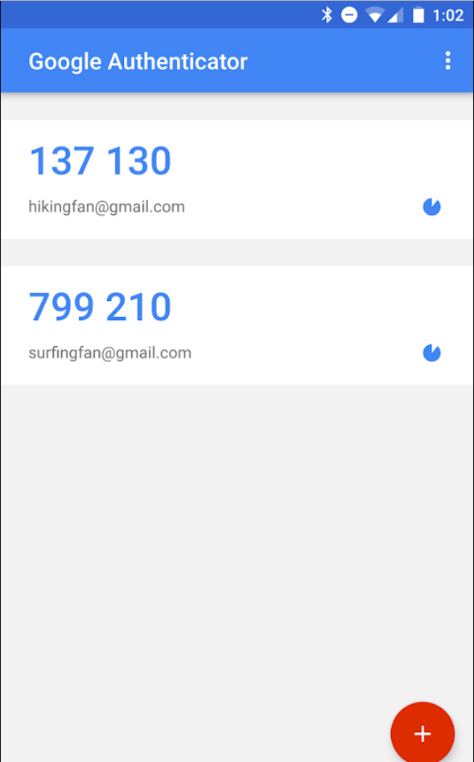
Software-Based Authentication
One-Time, Time-based
Given an initial secret, your phone can generate a unique code that changes at known intervals, forever.
The website uses the shared key to verify the same code.

Slide 23
Software-Based Authentication
An Authenticator “app” for your phone generates a number which you type in to the website, or approve via a push notification.
This is more secure than SMS-based MFA.

Slide 24
Software-Based Authentication Mobile Apps
Google Authenticator
Microsoft Azure Authenticator
LastPass Authenticator
Authy: multiplatform free service for soft MFA
Enterprise mobile apps:
Symantec VIP, RSA, Duo

Slide 25
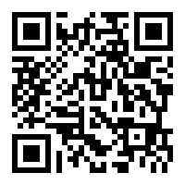
Software-Based Authentication Setup
When you set up, you’ll be provided a QR code (common) and/or long string that you only see once.
Pro tip: SAVE IT SECURELY for the future.
Use the same QR Code or string to transfer phones or create backup devices
Your phone holds the key. Which means if you lose your phone, you’ll want a backup method.

Slide 26
Certificate-Based Authentication Setup
Complimentary only.
After an initial secure authentication, allows a certificate to be placed on the device only.
Facebook and Windows 10 “pins” are similar.
New devices/login locations lack the certificate, cannot log in with out more secure authentication.

Slide 27
Certificate-Based Authentication Setup
Microsoft Hello is a push to eliminate recurring access via passwords that work every where with PINs (or biometric data, or other hardware MFA) linked to a device cert.
The initial login for the device must still be secured with MFA.

Slide 28
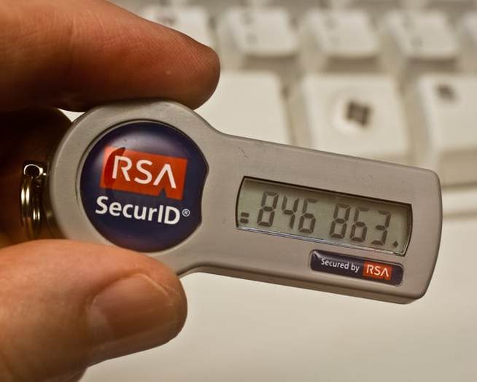
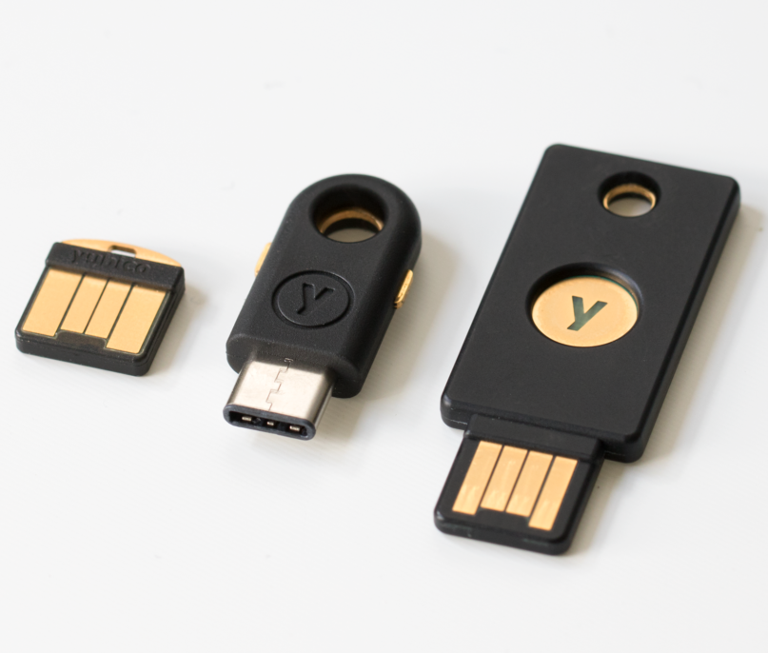
Hardware-Based Authentication
Very similar to Software-based authentication, but not on a phone or app, rather, generated by a simple microprocessor.
Or, a USB hardware key that integrates with software to provide MFA only when plugged-in.

Slide 29
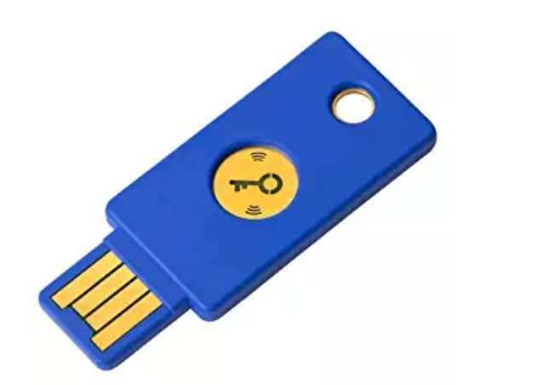
Hardware-Based Authentication
Ties physical security (your keychain?) to digital security, not something you may be used to. Will require you to change habits.
You should purchase and create duplicate keys for the same service with the same secrets, store one in a safe at home, for example.
Pictured: Yubikey ($20 on Amazon)

Slide 30
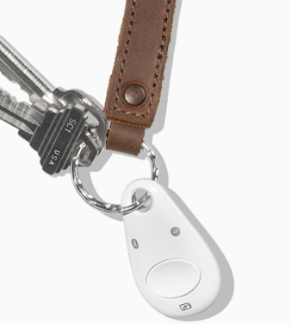
Hardware-Based Authentication
You need MFA for logging into accounts via your phone too.
Google’s Titan (right) has Bluetooth, NFC, and microUSB.

Slide 31
Can’t Trust Google Implicitly, But
Google provided MFA to all accounts as early as 2010.
Google offers a free Advanced Protection platform utilizing hardware MFA for “anyone at risk of targeted attacks – like journalists, activists, business leaders, and political teams.” Imagine if we had this in 2016. https://landing.google.com/advancedprotection/
“Google has not had any of its 85,000+ employees successfully phished since early 2017, when it began requiring all employees to use physical Security Keys in place of passwords and one-time codes.” https://krebsonsecurity.com/2018/07/google-security-keys-neutralized-employee-phishing/

Slide 32
Personal Practical Cybersecurity
MFA and website integration are relatively immature but advancing.
Efforts are hindered by the cost and sophistication but mostly hindered by user resistance to change.

Slide 33
More Reading
How Russian Cyberpower Invaded the U.S. https://www.nytimes.com/2016/12/13/us/politics/russia-hack-election-dnc.html
Your password has probably been stolen. Here’s what to do about it. https://www.washingtonpost.com/technology/2018/07/12/your-password-has-likely-been-stolen-heres-what-do-about-it/
How to protect yourself from 'spear phishing' hacking technique https://phys.org/news/2018-07-spear-phishing-hacking-technique.html
Reddit Breach Highlights Limits of SMS-Based Authentication https://krebsonsecurity.com/2018/08/reddit-breach-highlights-limits-of-sms-based-authentication/
This is why you shouldn’t use texts for two-factor authentication https://www.theverge.com/2017/9/18/16328172/sms-two-factor-authentication-hack-password-bitcoin
Two-Factor Authentication: Who Has It and How to Set It Up https://www.pcmag.com/feature/358289/two-factor-authentication-who-has-it-and-how-to-set-it-up
Hackers beat 2-factor protection with automated phishing attacks https://mashable.com/article/hackers-beat-two-factor-authentication-2fa-phishing
Creating the Unphishable Security Key: How the FIDO U2F security key and YubiKey stop phishing and man-in-the-middle attacks www.yubico.com/2017/10/creating-unphishable-security-key/
What is two-factor authentication, and which 2FA solutions are best?https://www.pcworld.com/article/3225913/what-is-two-factor-authentication-and-which-2fa-apps-are-best.html
The Limits of SMS for 2-Factor Authentication https://krebsonsecurity.com/2016/09/the-limits-of-sms-for-2-factor-authentication/
Major SMS security lapse is a reminder to use authenticator apps instead https://www.theverge.com/2018/11/16/18098286/vovox-security-breach-two-factor-authentication-2fa-codes-exposed
Metro Bank targeted with 2FA-bypassing SS7 attacks https://www.itpro.co.uk/security/32898/metro-bank-targeted-with-2fa-bypassing-ss7-attacks
Secure password-less sign-in for your Microsoft account using a security key or Windows Hello https://www.microsoft.com/en-us/microsoft-365/blog/2018/11/20/sign-in-to-your-microsoft-account-without-a-password-using-windows-hello-or-a-security-key/

Slide 34
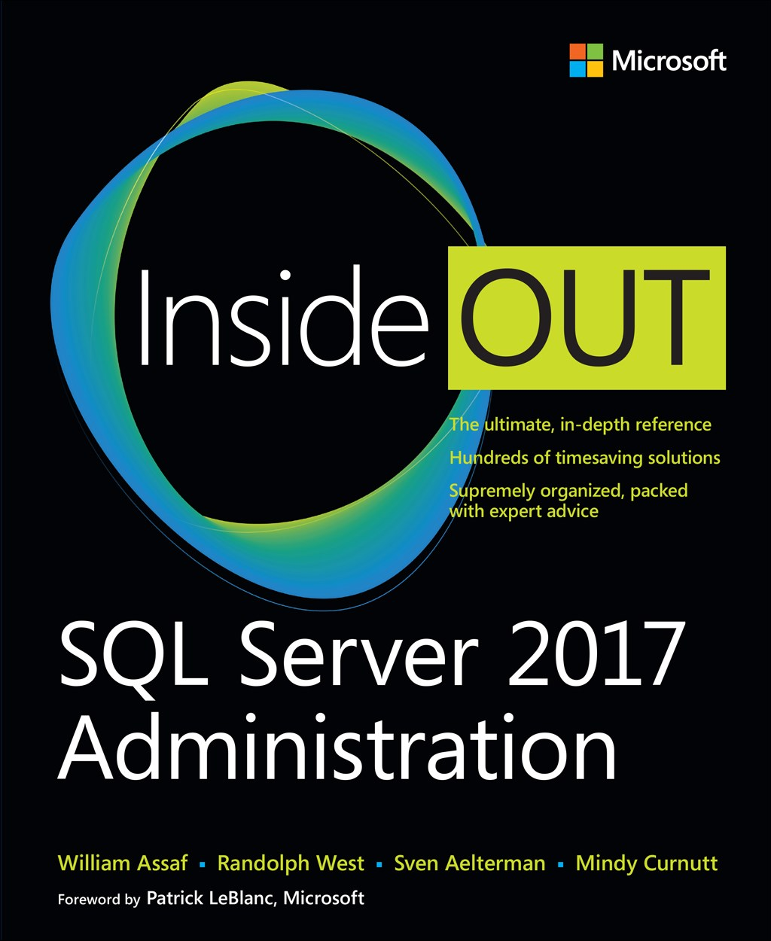
SQL Server 2017 Administration Inside Out
Published Feb 2018 by Microsoft Press
2nd edition for SQL 2019 coming Q1’2020*
*just a guess

Slide 35
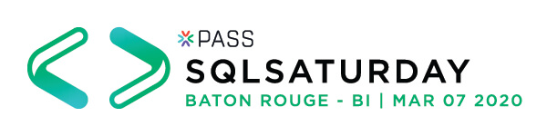
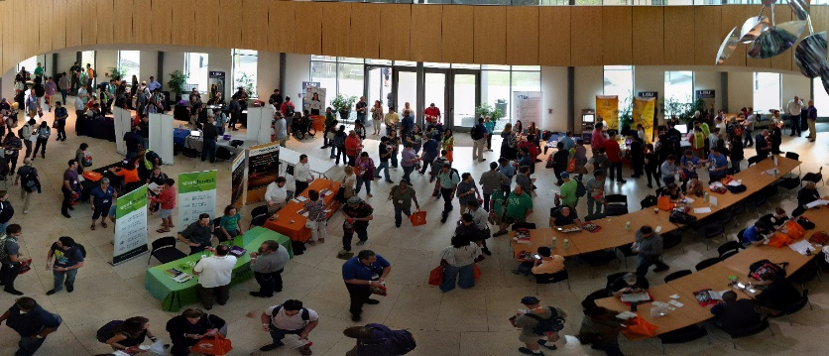
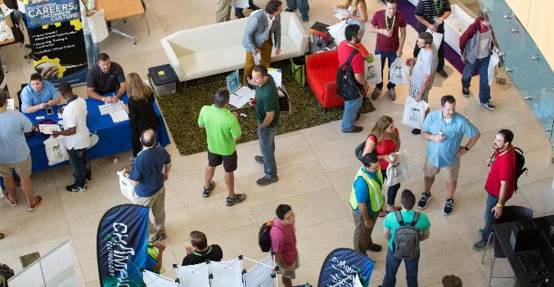
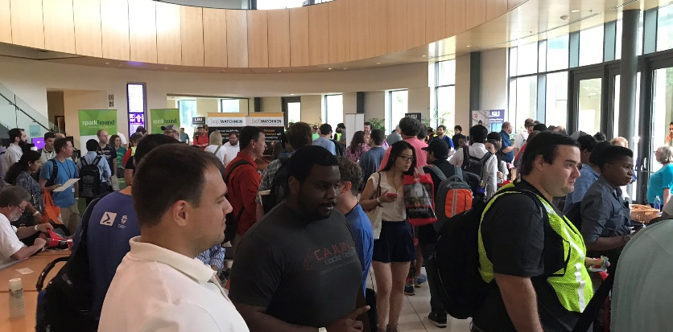

Free SQL Server, .NET, Business Intelligence training and more!
An all day FREE training event with Data Analytics related sessions spread out over multiple tracks of Business Intelligence, SQL Server, Tableau, Power BI,
Career Development, and CIO/IT Management
See you March 7 in Taylor Hall!
SQLSatBR.com

Slide 36

Bio and contact
William D Assaf, MCSE
Baton Rouge SQL UG and SQLSatBR organizer
Principal Consultant and Sparkhound Inc.
Twitter: @william_a_dba
linkedin.com/in/williamdassaf
This presentation, including all source code, available at this SQLSaturday’s schedule page and at my blog:
SQLTact.com

